Slide 1
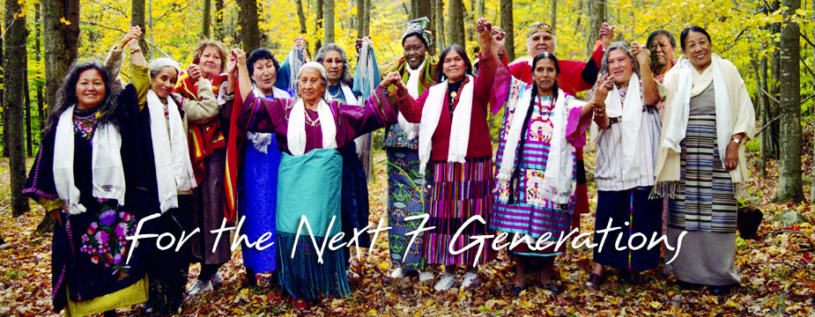

International Council of the Thirteen Grandmothers
Notes:
Ancestors is a song written collaboratively at the Tree of Life School, a weekly program for girls focused on the wisdom of the International Council of the Thirteen Grandmothers. The Council is a global alliance of prayer, education and healing for our Mother Earth, all Her inhabitants, all the children, and for the next seven generations to come… They say “We join with all those who honor the Creator, and to all who work and pray for our children, for world peace, and for the healing of our Mother Earth. For all our relations.”

Slide 2
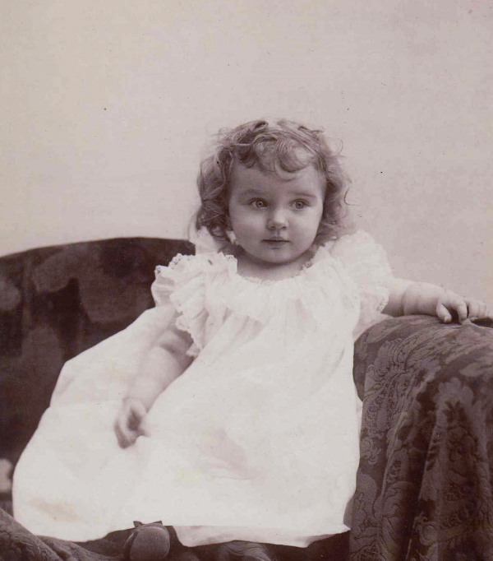
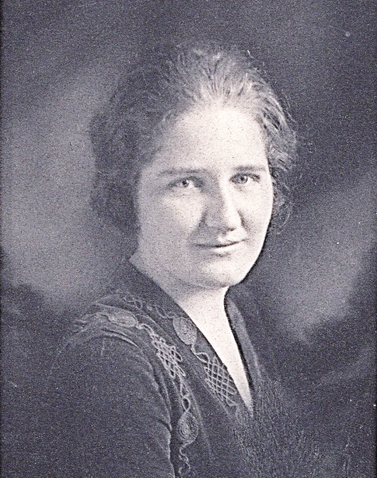
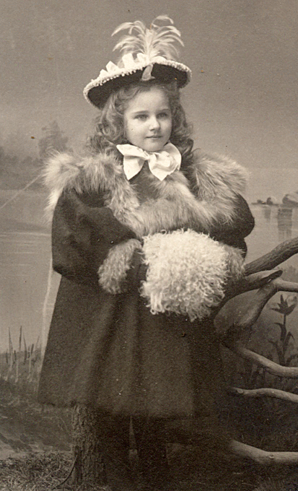
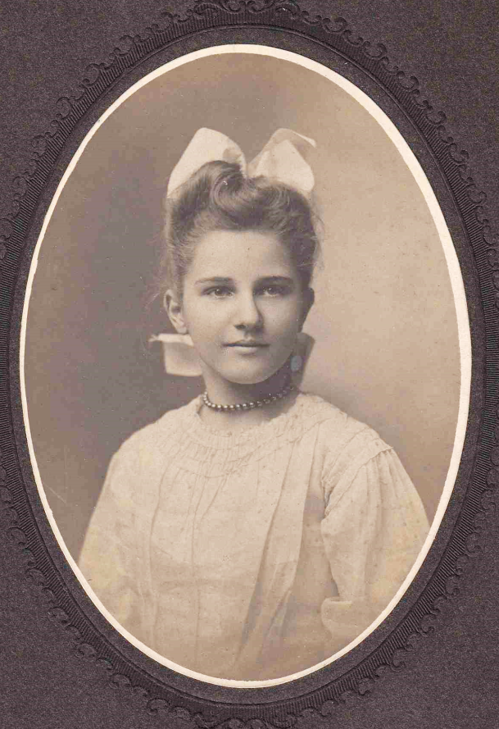
We are standing on the shoulders of the ones who came before us.
They are giving us their courage, and they say “We are glad you’re in this world.”

Slide 3
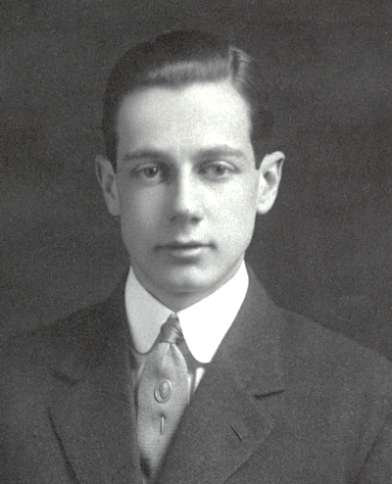
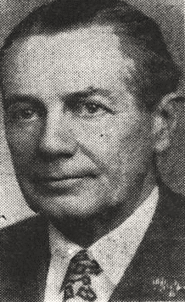
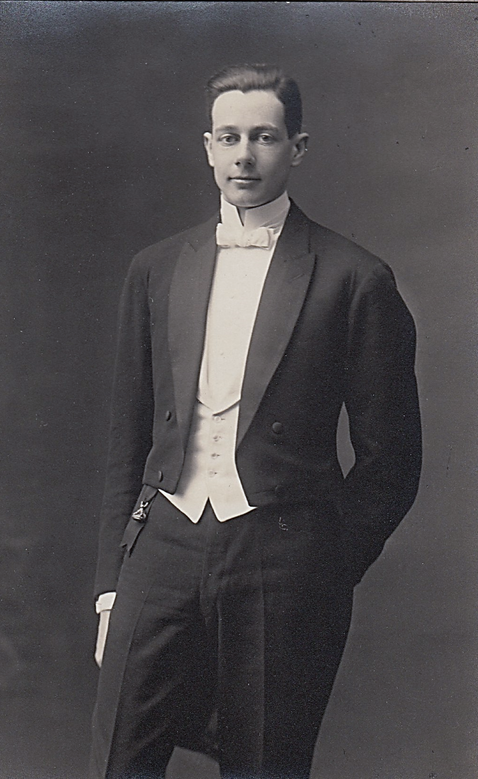
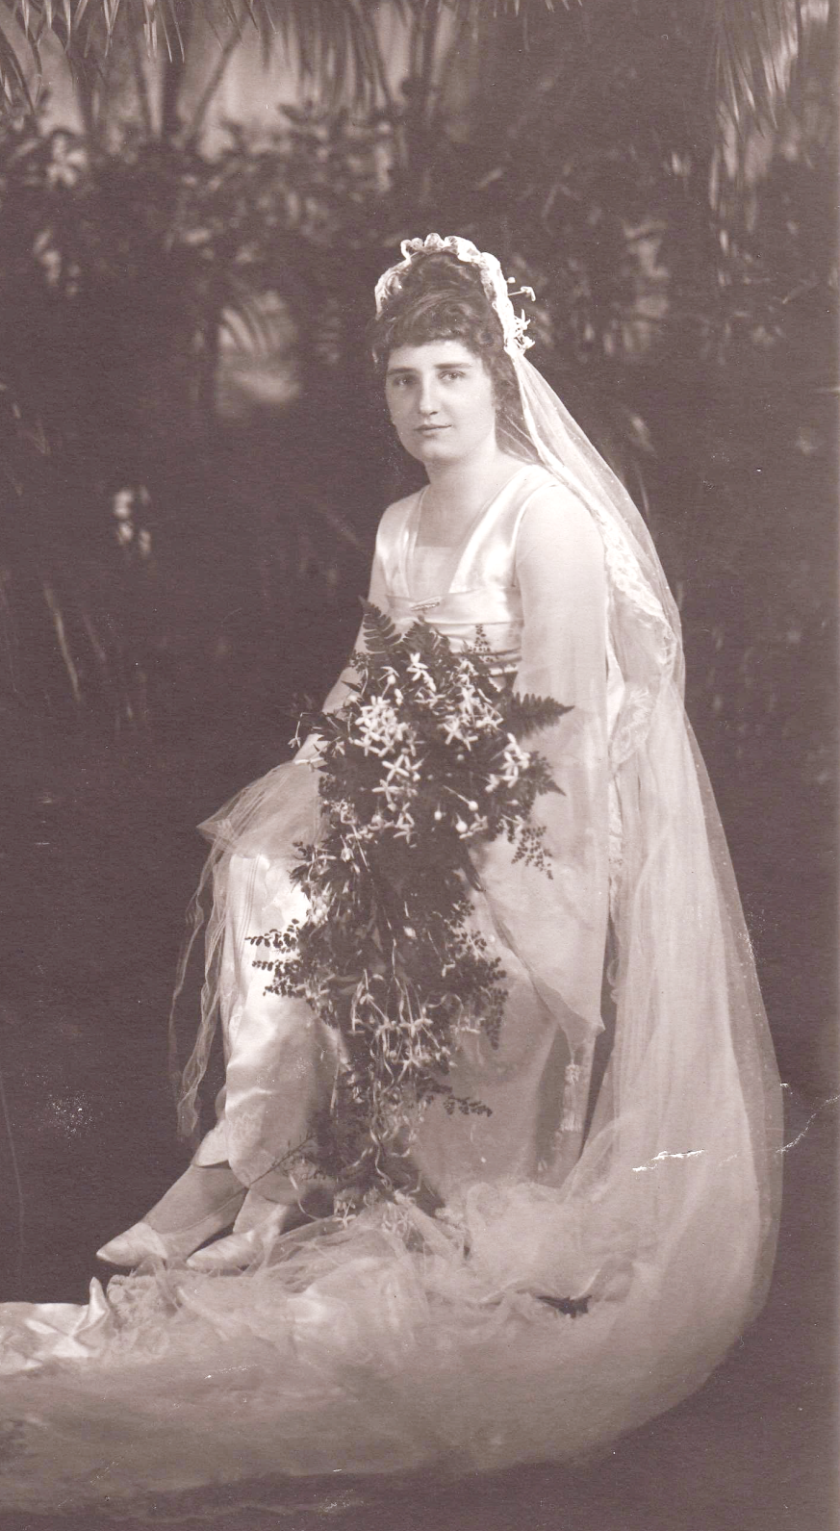
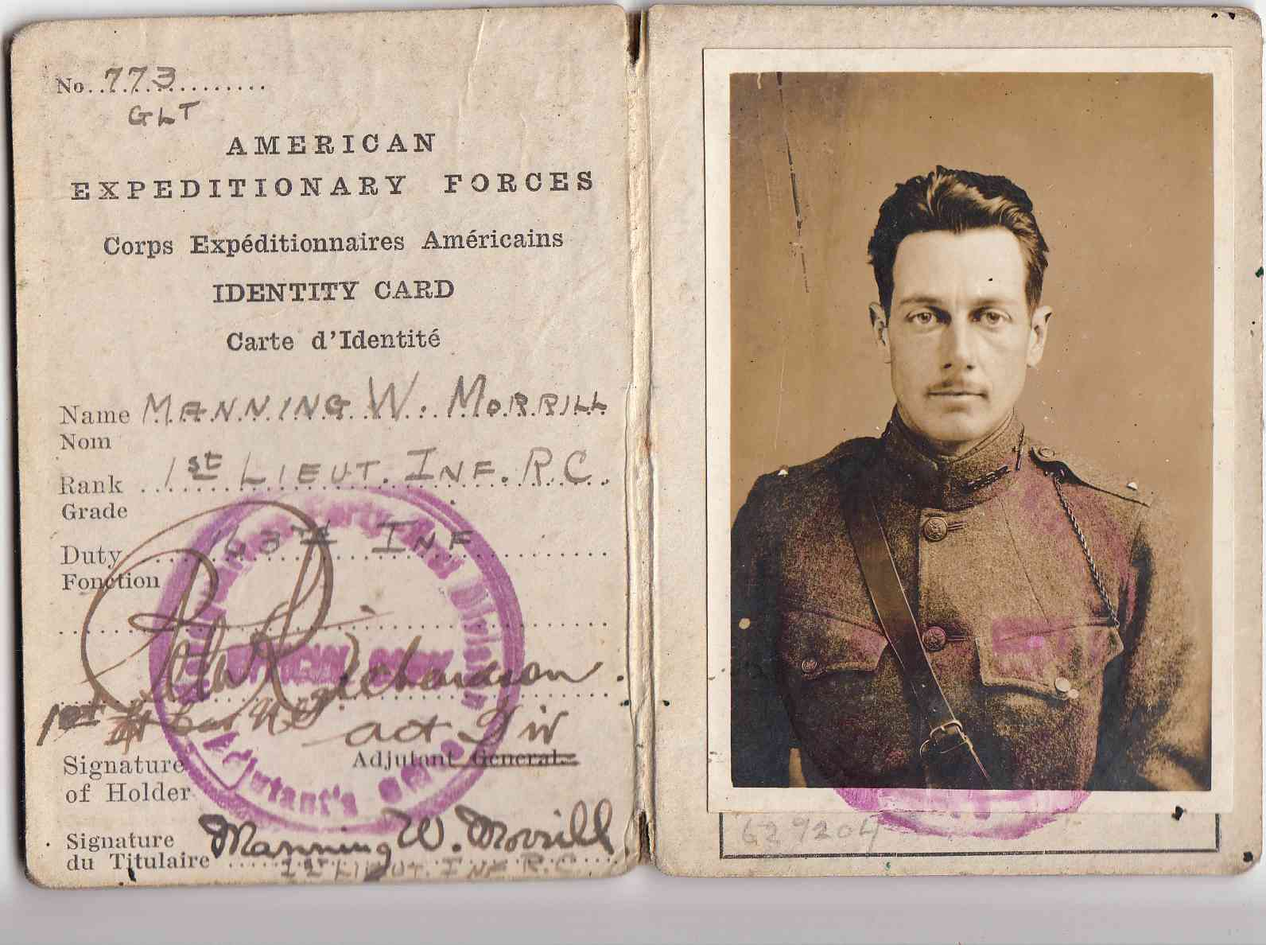
May the strength of the ancestors encircle you.
May the strength of the ancestors encircle you.
And may this strength stay with you your whole life through.
May the strength of the ancestors encircle you.

Slide 4
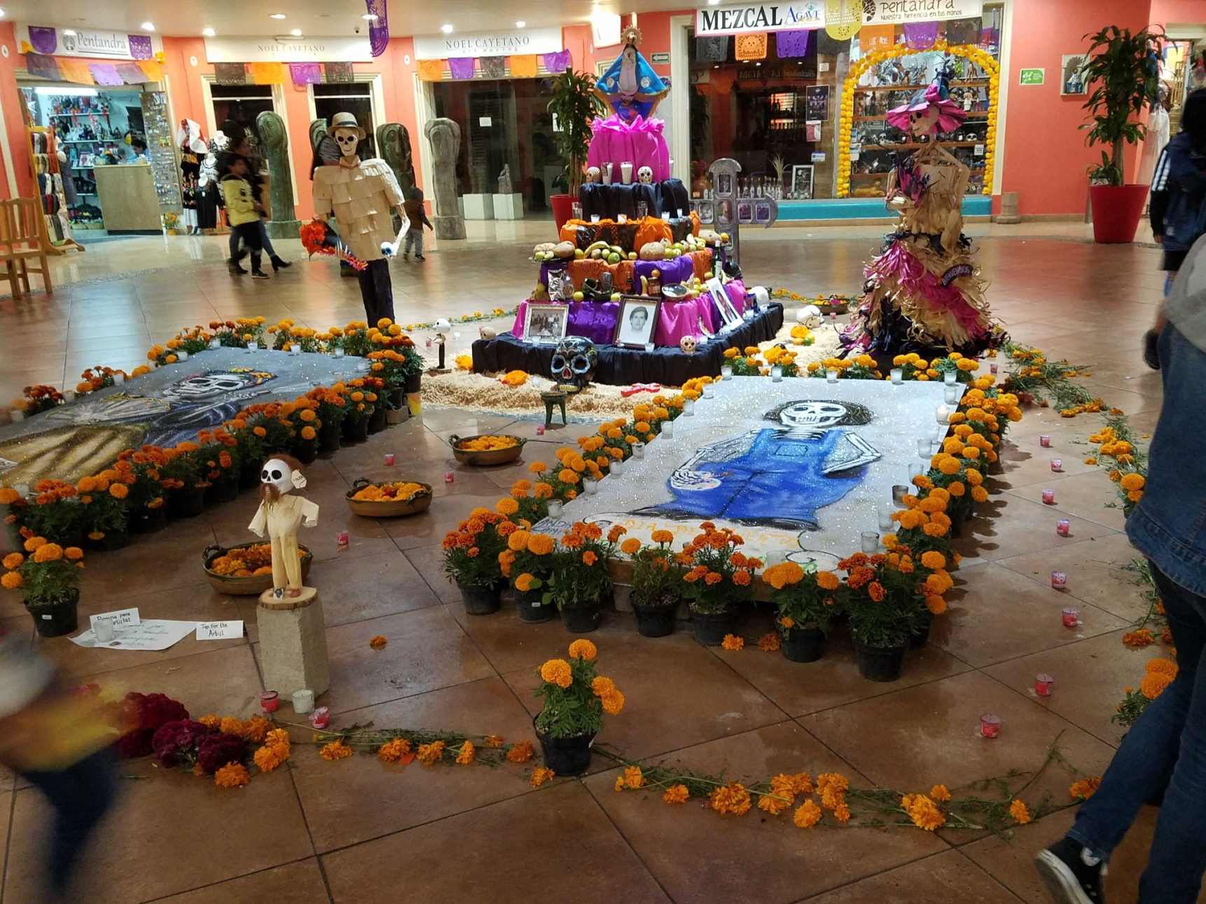
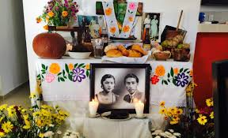

Slide 5
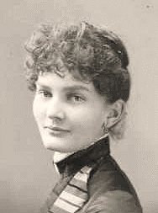
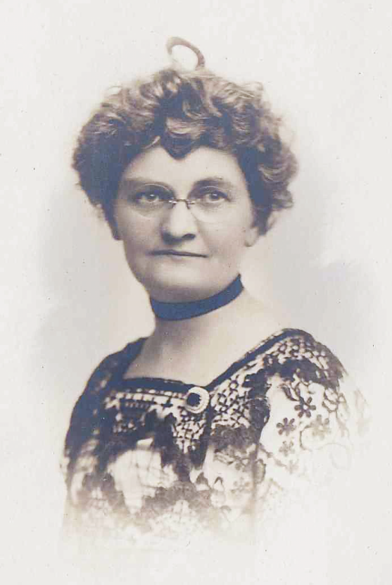
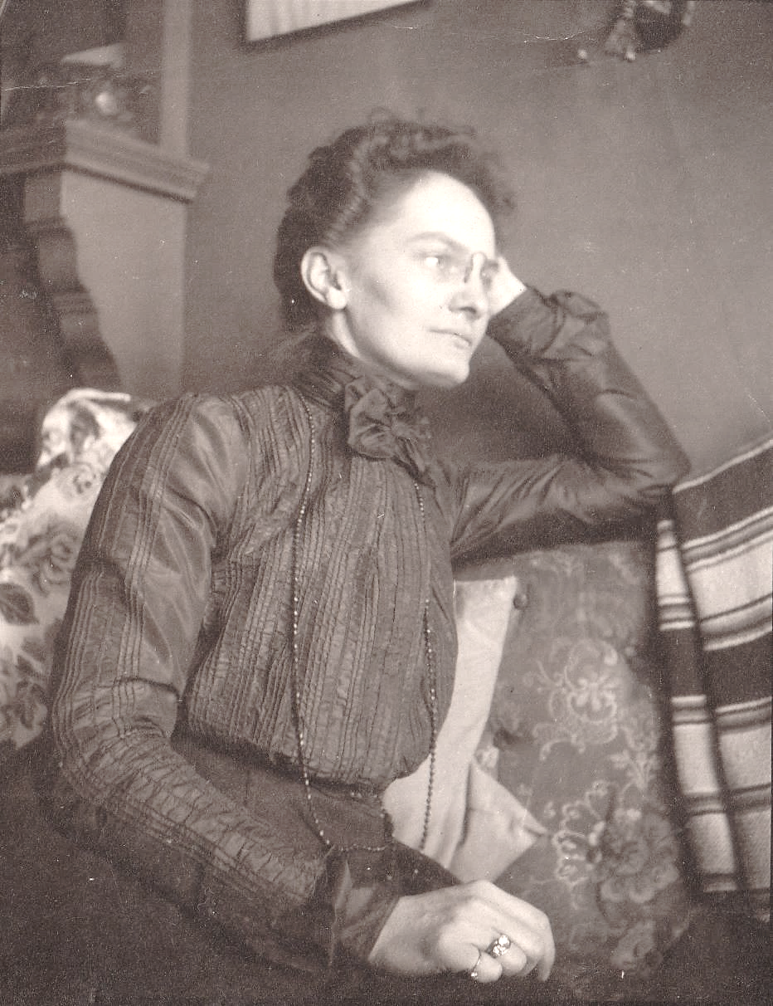
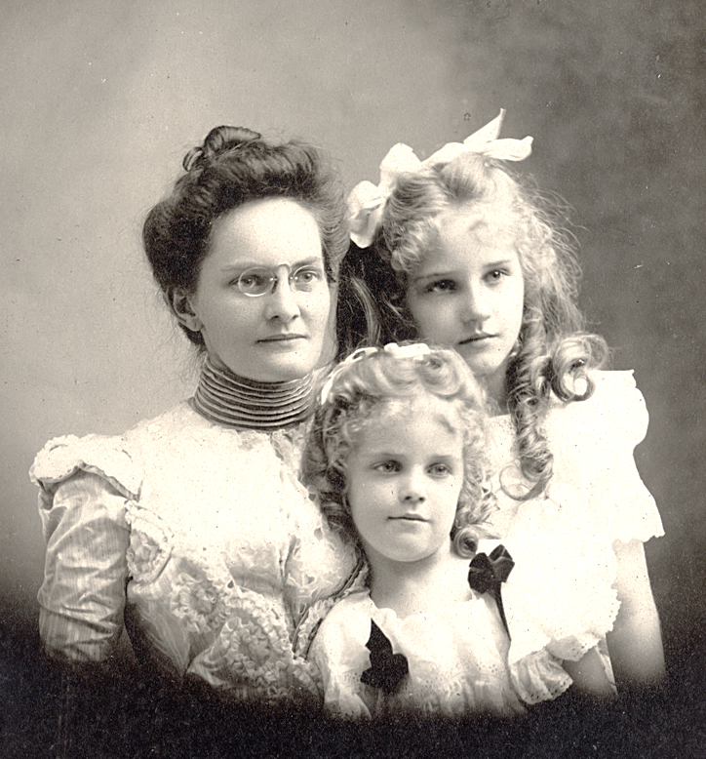
We are standing on the shoulders of the ones who came before us.
They are giving us their courage, and they say “We are glad you’re in this world.”

Slide 6
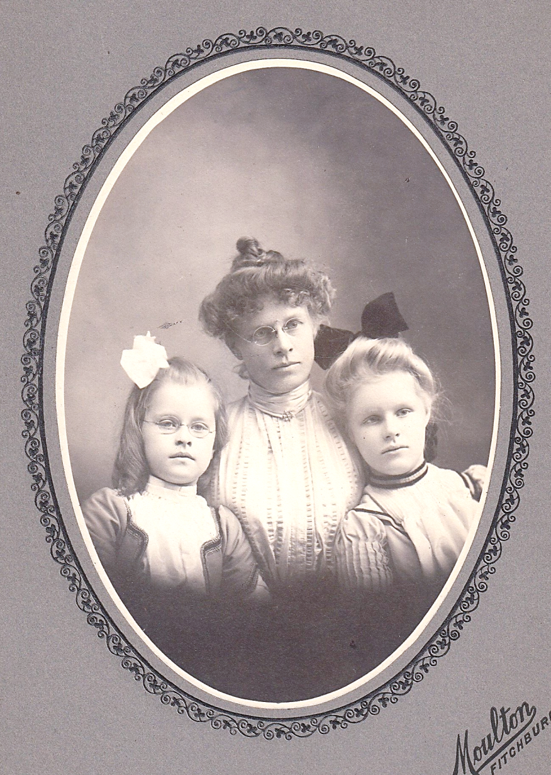
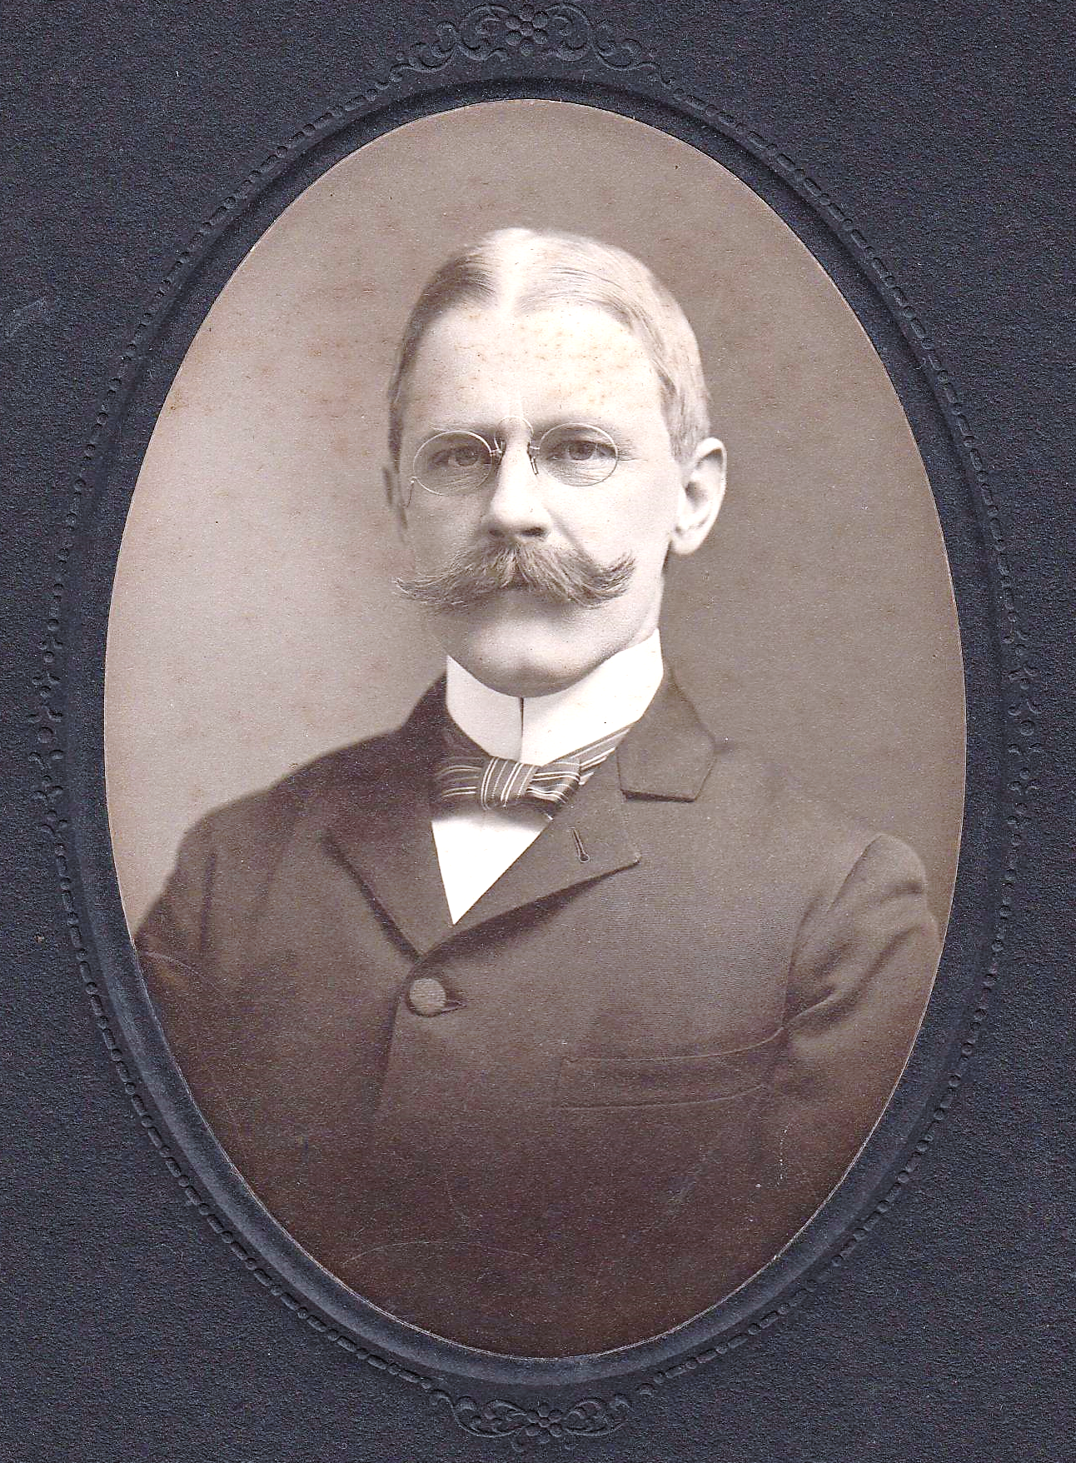
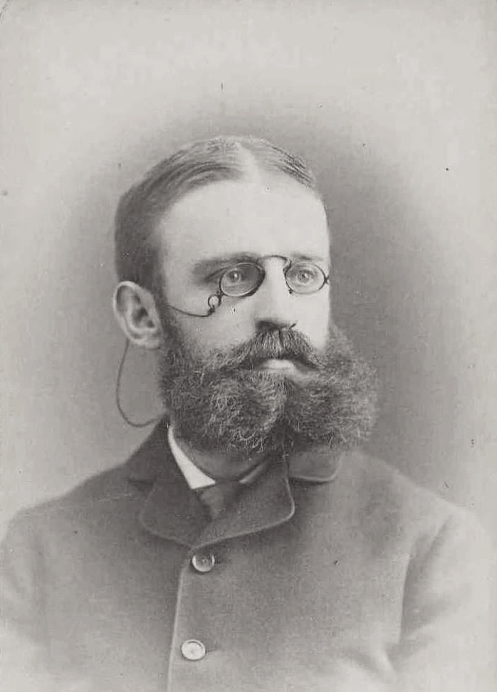
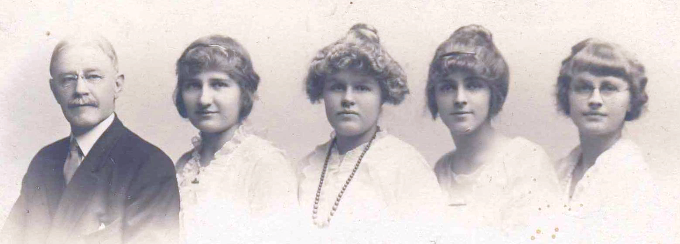
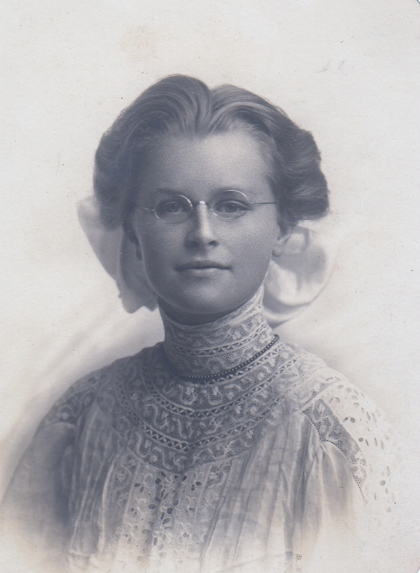
May you have all your choices.
May you have all your voices.
May your wisdom now be heard.
They say “We are glad you’re in this world.”

Slide 7
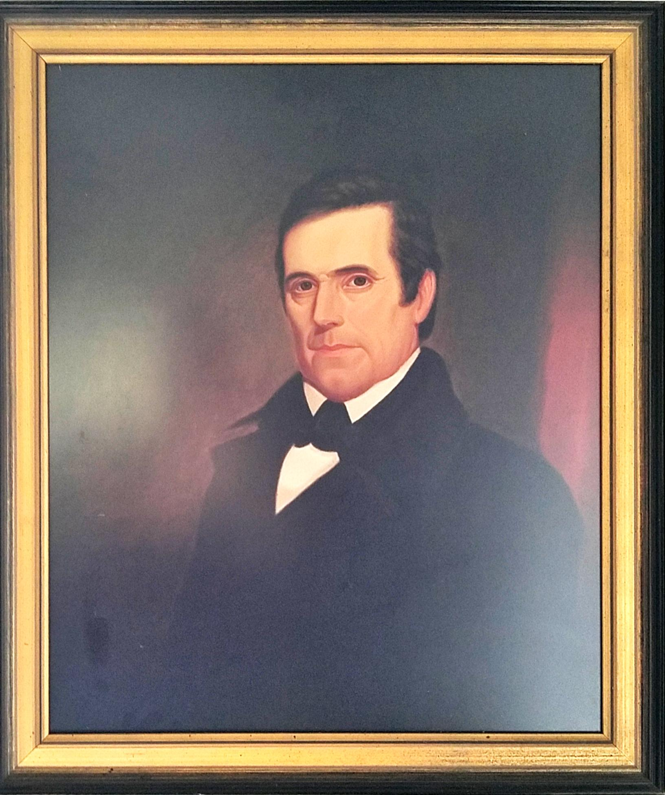
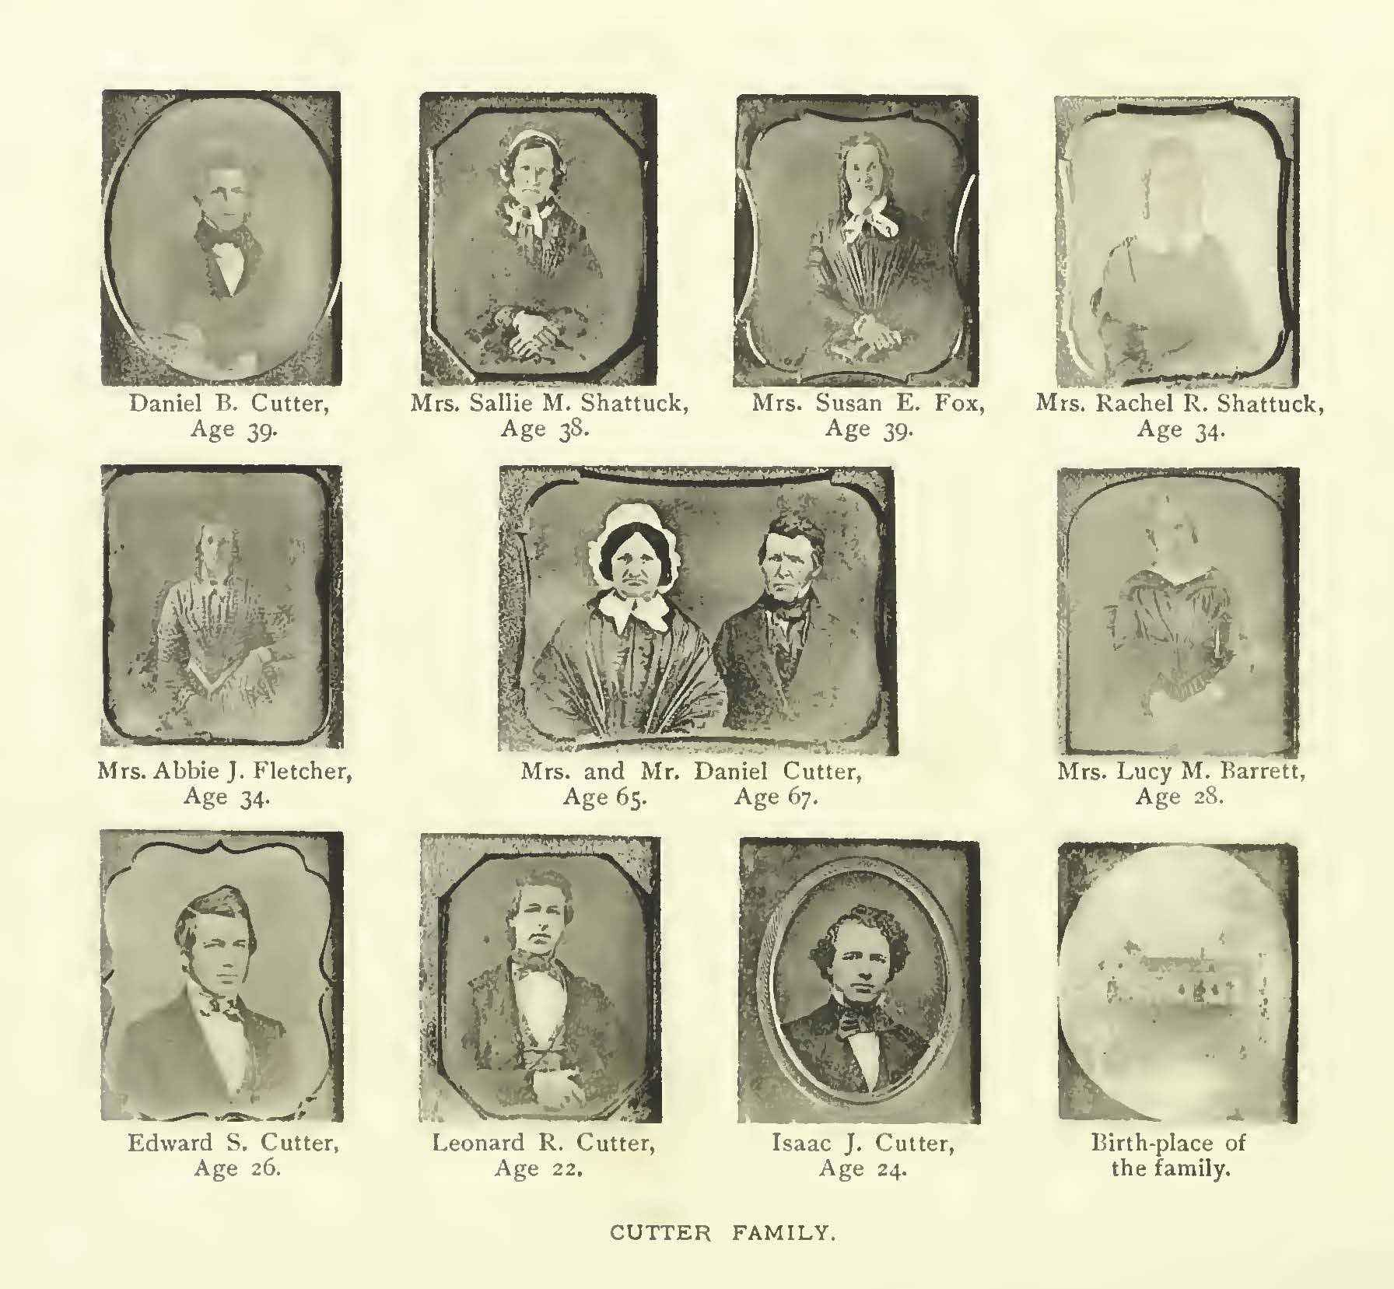
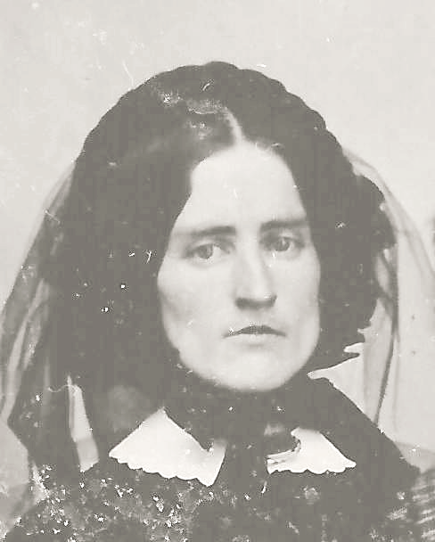
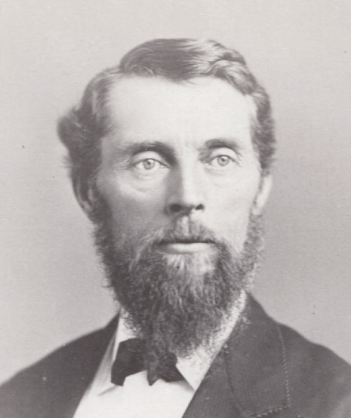
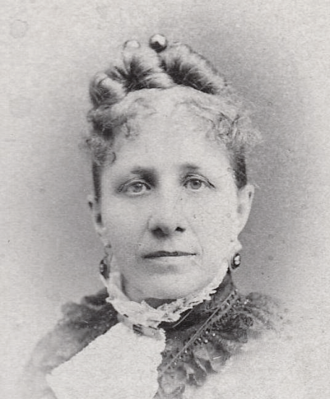
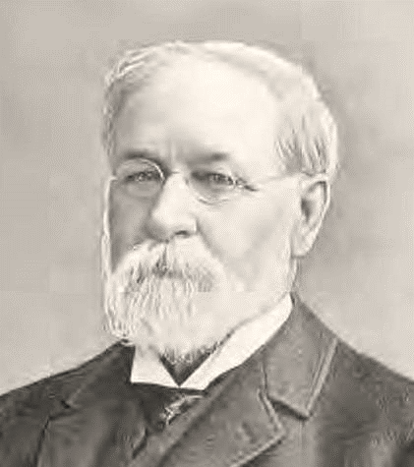
May the trust of the ancestors be healing you.
May the trust of the ancestors be healing you.
And may this trust stay with you your whole life through.
May the trust of the ancestors be healing you.

Slide 8
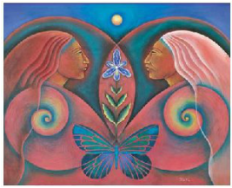
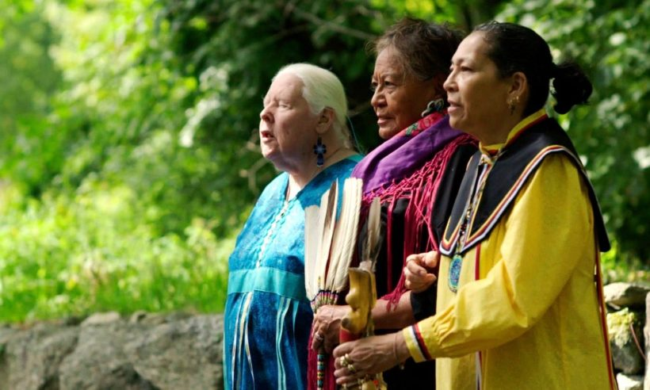

Slide 9
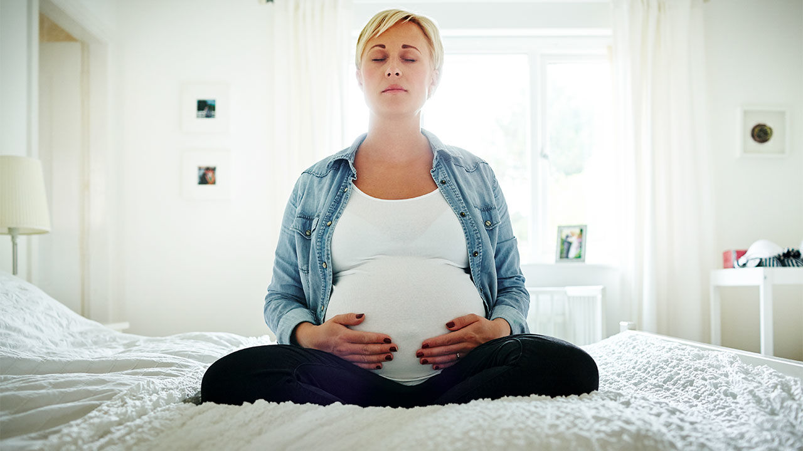
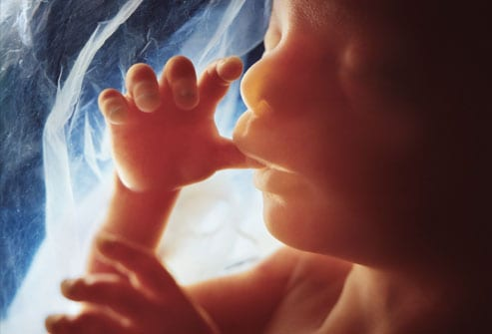
We are lifting up our vision to the ones who will come after.
We are sending them our courage, as they wait to come into this world.

Slide 10
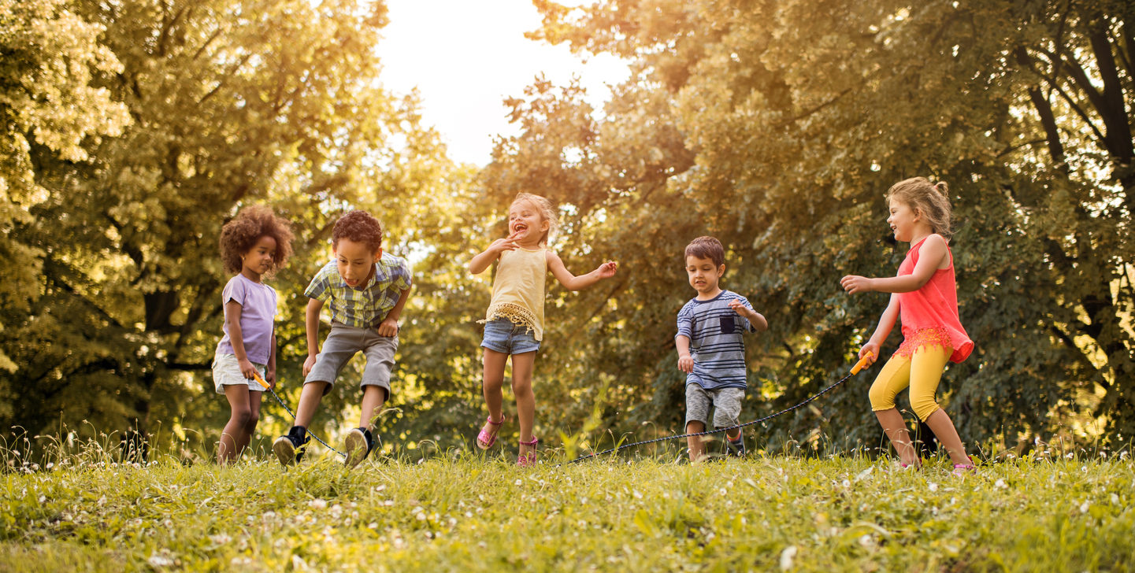
May you have all your choices.
May you have all your voices.
May your wisdom now be heard.
They say “We are glad you’re in this world.”

